Slide 1
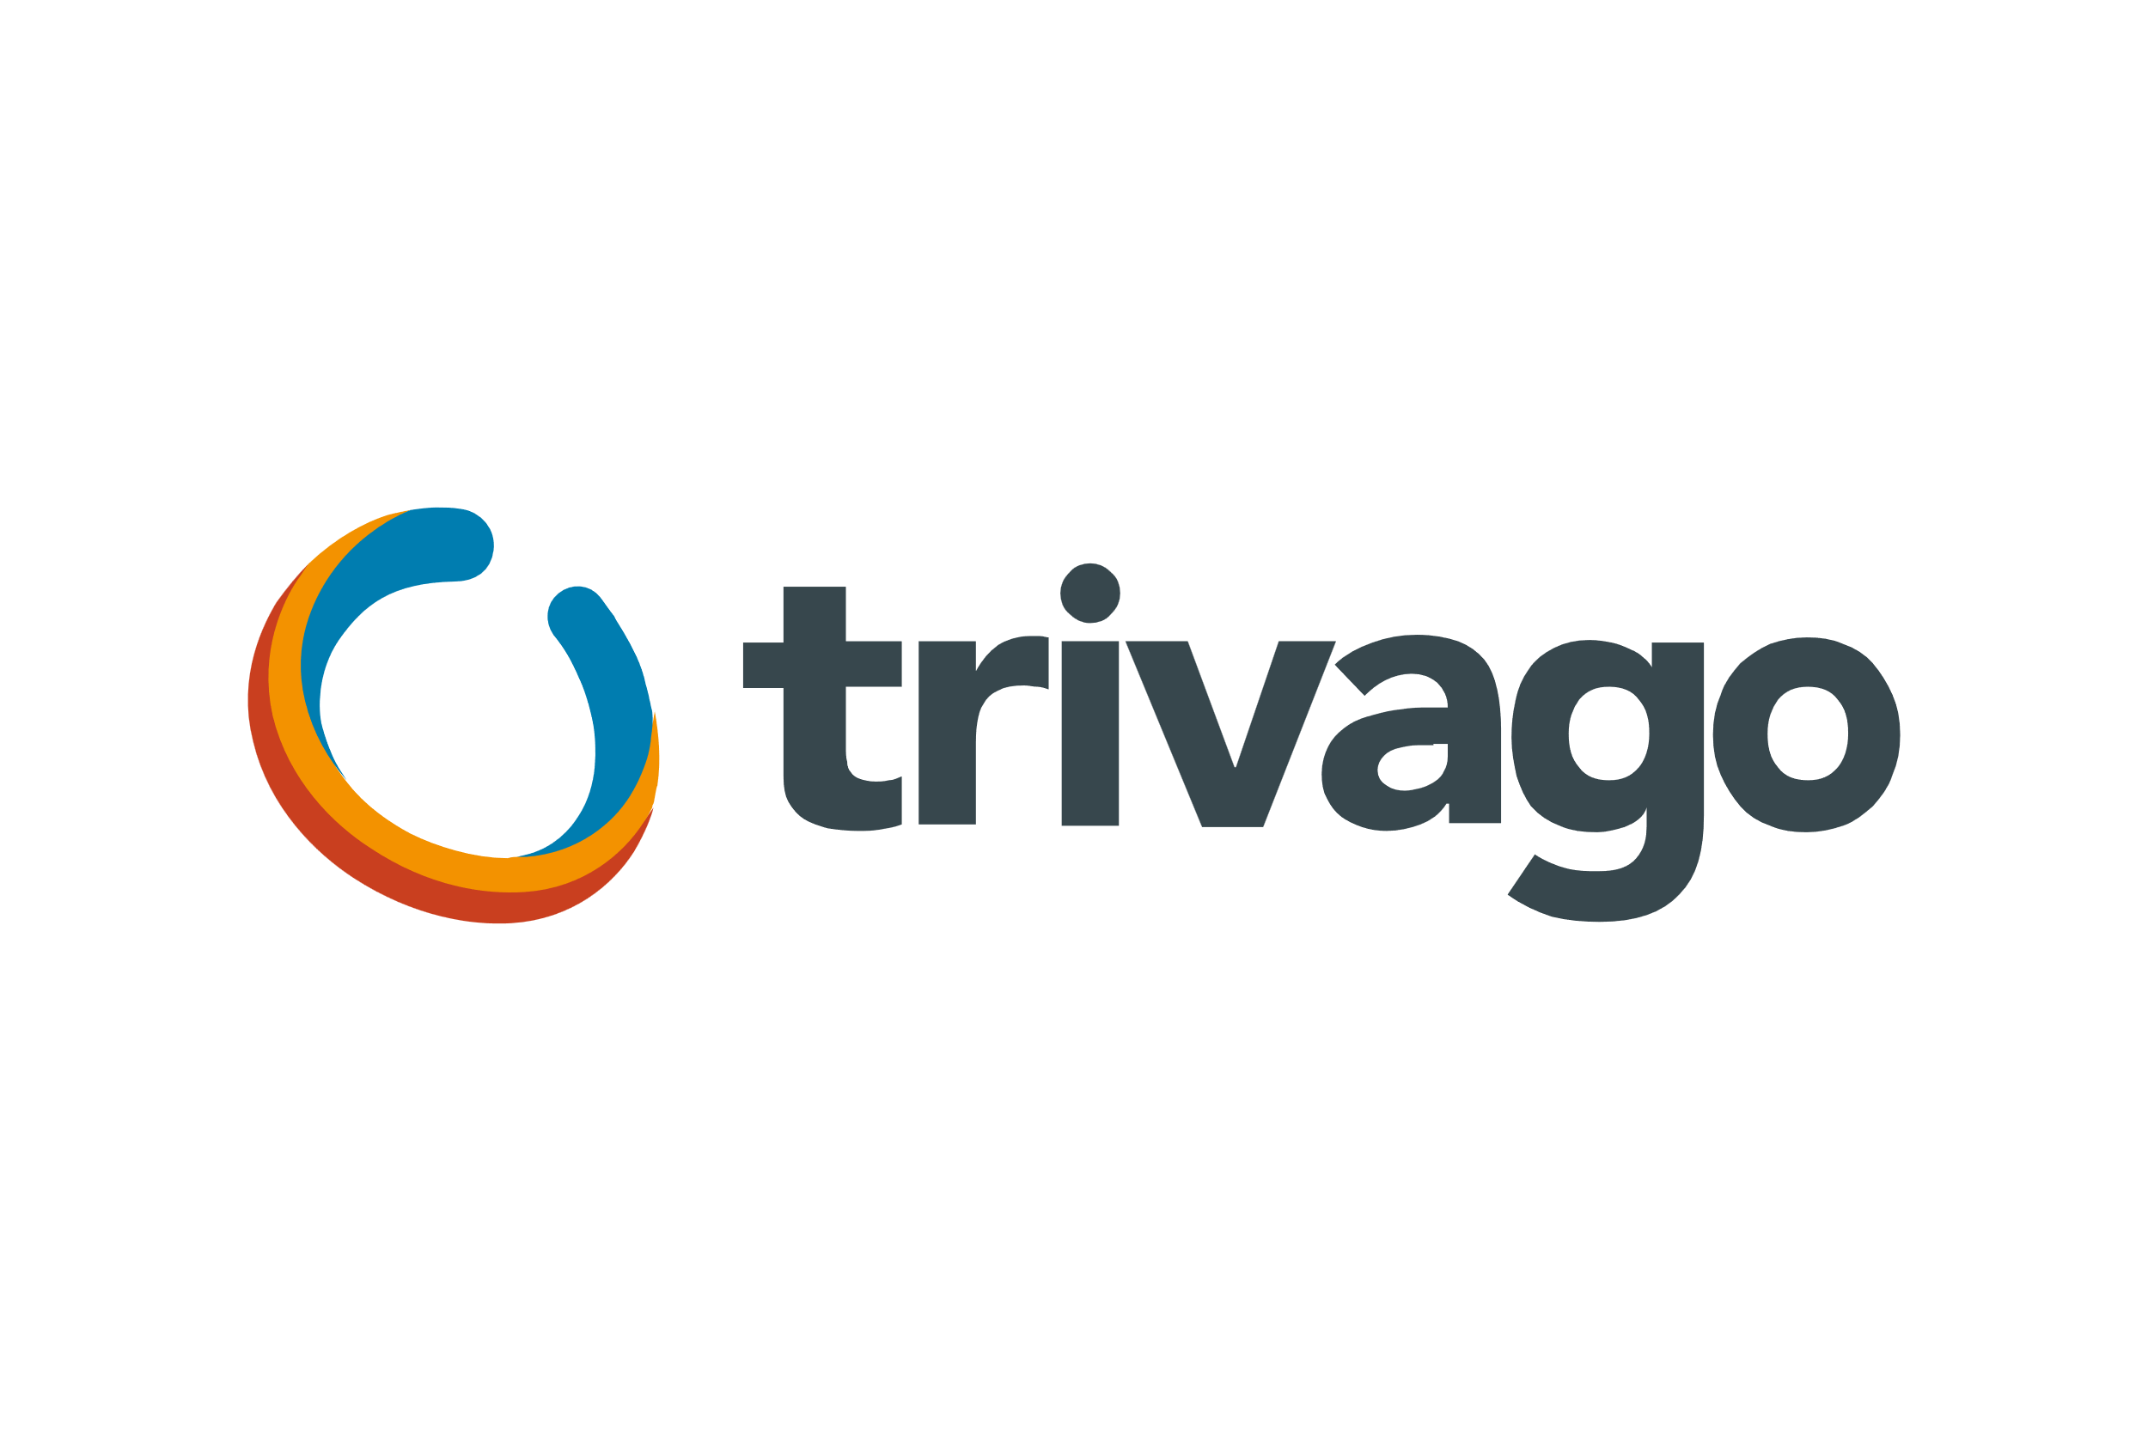
Data Analyst - Product Intelligence
Case Study
By Oluwatobi Ojo

Slide 2

trivago
Task 1
Session Investigation

Slide 3

Challenge 1 - Descriptive Analysis
Trivago operates as a meta search engine company for accommodations around the world and offering accurate comparisons and recommendations for its users making profit from charging platforms onboarded from clicks, listings, advertisements, subscriptions etc.
This to me means as much as possible we need to keep users engaged on the platform and determine what is key to track, which features drives adoption, are the users willing to come back, and how much is done by a user during sessions.
Let’s dive in, I’ll put up some of the basic things from the data to explore and explain my findings.
- Data structure (data cleaning around the country_name column)
- Statistical measures of numerical columns in the dataset (clickouts, bookings, session_duration, total_ctp)
- Distribution of sessions across various categorical columns such as device used, platform, traffic type etc.
- How does specific categorical columns influence clickouts, retention rate (repeat visitor rate)
- Time series analysis of sessions
- Relationships/patterns between specific variables in the data
Nb: Note that this report does not prioritize the analysis of Bookings, as Trivago's revenue model does not rely on this Key Performance Indicator (KPI).

Slide 4
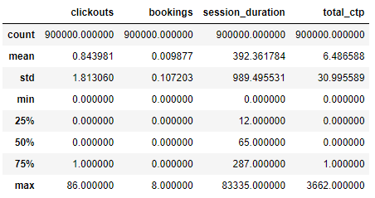
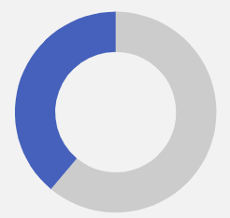
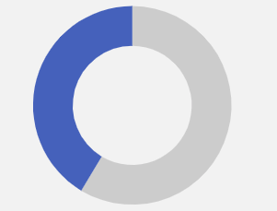
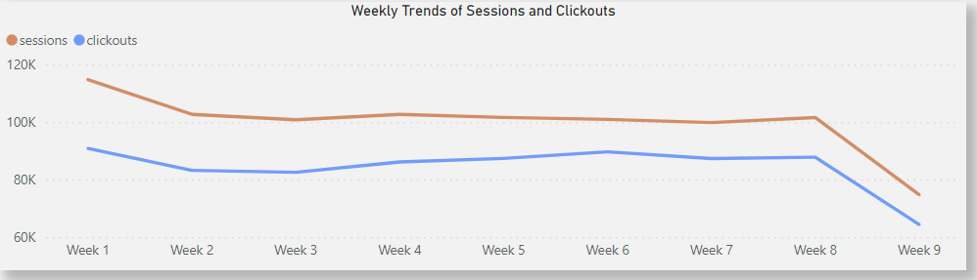
Statistical Measures
Does the device used, platform of usage, traffic/marketing channel in which the user originate from matter
Has the app usage changed over time positively, could be because of newer features added or product team making modifications
39%
41%
Checking just repeat users
Only 39% of sessions led to the user making at least a clickout
Only 41% of sessions by repeat users led to the user making at least a clickout
Nb: To be certain the large values are not outliers, and they are distributed across a number of sessions, I also plotted a boxplot to view the distributions, which showed they are not isolated outliers.
This shows that being a repeat user has little or no effect in determining if a user gets to make a clickout during a session
This shows that on an average, most sessions did not make clickouts, spent averagely just about a minute on the site and viewed less than a content when they visited the site. These are worrisome findings, and I would suggest exploring more on the reasons that could be behind these behaviors. Asking questions like;
%of sessions that ended up making at least a click vs ones that didn’t.
Does being a repeat user affect usage of the product positively compared to those who aren’t repeat users.
This shows there has been a slight decline in the number of sessions and clickouts from the launch till date. This is a worry as these trends should tend to increase as modifications are made on the product.

Slide 5
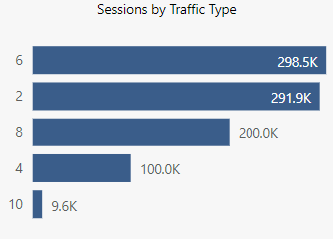
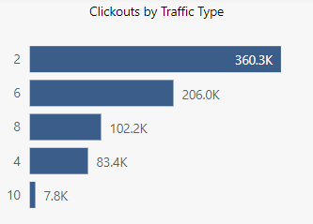
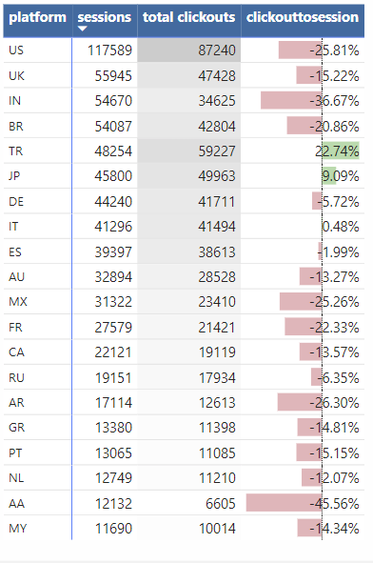
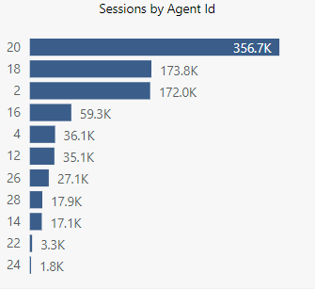
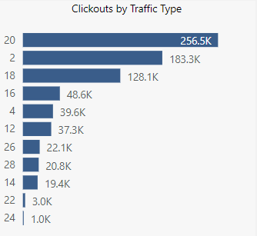
Categorical Variables Distribution
Traffic Type (marketing channel)
Platform (country code) – top 20 by sessions
Clickouttosession =
(Total clickouts – sessions) *100
sessions
The charts highlight traffic sources' performance in driving user engagement and clickouts. Traffic source 6 exhibits low effectiveness in prompting user clickouts, whereas Traffic source 2 significantly excels in encouraging user engagement through clickouts.
Agent Id (device type)
The analysis displays the top 20 countries based on session counts, total clickouts, and clickouts per session. Despite lower session counts in country codes TR and JP, their clickout rates are significantly high. Further investigation would be warranted to understand the comparatively lower clickout rates in other countries.
The charts highlight device used performance in driving user engagement and clickouts. Device 18 exhibits low effectiveness in prompting user clickouts, whereas device 2 significantly excels in encouraging user engagement through clickouts.

Slide 6
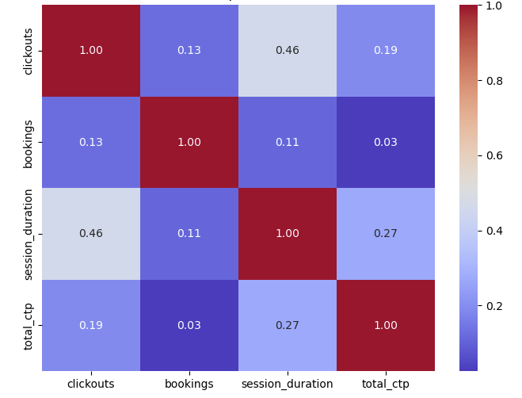
Relationships between Numerical Variables
The heatmap shows the correlation matrix between specific numerical variables in the dataset. It reveals varying degrees of correlation among the variables. Specifically:
Clickouts and Session Duration display a moderate positive correlation of 0.46, indicating a tendency for longer sessions to have more clickouts.
Session Duration and Total_ctp exhibit a moderate positive correlation of 0.27, suggesting a not so strong connection between session length and the total content viewed.
Clickouts and Total_ctp demonstrate a moderate positive correlation of 0.19, hinting at a relationship between the number of clickouts and the total content viewed.
Bookings have a relatively weaker correlation with the other variables, showing low correlations ranging from 0.03 to 0.13 with Clickouts, Session Duration, and Total_ctp.

Slide 7
Observations
Important Metrics
The data had formatting issues(csv structure in a .xlsx file), particularly in the 'country_name' column with multiple commas, necessitating extensive cleaning to ensure data accuracy and integrity across all columns.
Consider prioritizing the development of a mobile app (seeing as no session was performed on a mobile app) to improve user engagement on a more user-friendly platform. Additionally, if a mobile app already exists, encourage users to utilize it for a better experience.
With under 40% of sessions leading to at least a clickout and a minute average session durations, users may struggle to find available accommodations. Considering an AI chat feature for personalized recommendations or boosting listings on platforms with higher sessions but fewer clickouts could be a viable strategy.
Certain traffic/marketing channels exhibit higher efficiency in directing users more prone to making clickouts compared to others, despite having similar or lower session counts. Allocating increased advertising revenues to these high-performing traffic channels is recommended.
Investigating the gradual decline in sessions since the product's launch on May 1st is essential. Strategies to encourage user revisits and focus on effective marketing channels directing users to the product may be beneficial.
Enhancing user engagement through interactive features could boost clickouts, considering the moderate positive correlation between clickouts and session duration.
Clickout Ratio
Repeat Visitor Rate
Time series analysis of engagement metrics such as average contents viewed per session with time
Traffic source performance for the various metrics above
Platform performance for the various metrics above
Agent id (device type) performance for the various metrics above
Page entry and exit rates (for user actions, to see which pages/actions are prone to drop offs)

Slide 8

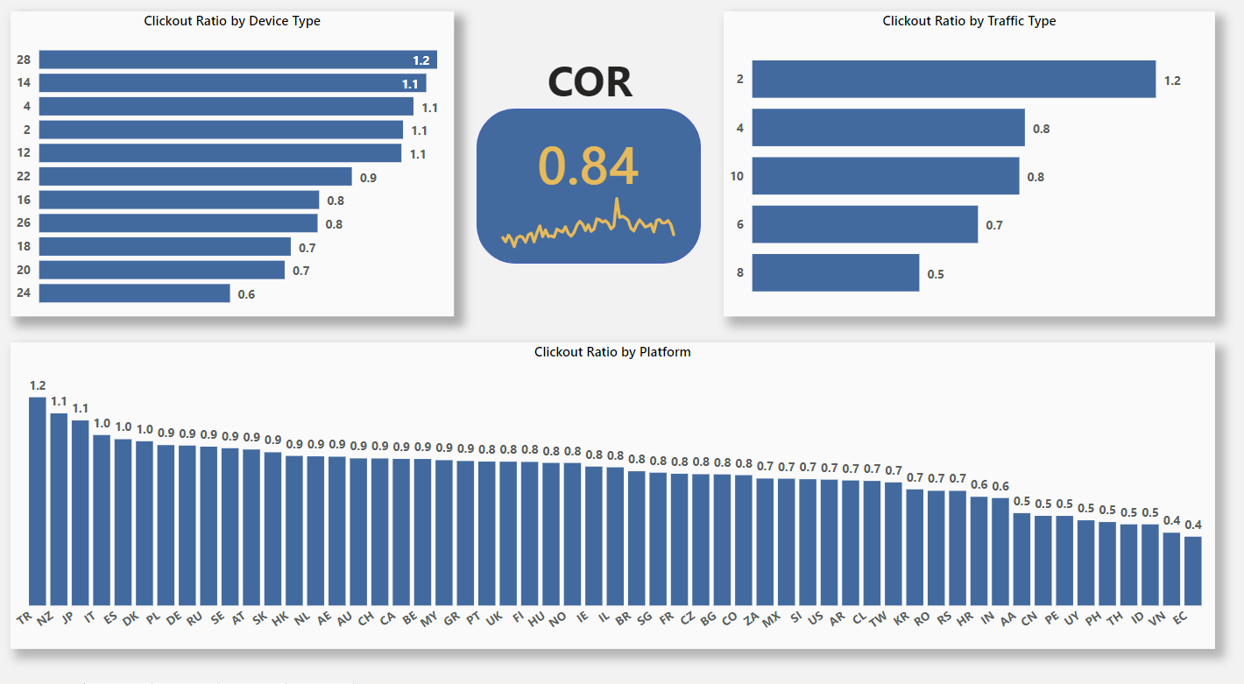
Challenge 2 – Clickout Ratio (COR)

Slide 9
Observations
Platform with the highest COR – Platform TR
Device with the lowest COR – Device 24
Are there differences by traffic type – Yes , there are significant differences, with traffic type 2 having about 50% more COR over any other traffic type.
Upon examining session counts in page 4 and clickout ratios (COR) among different traffic types, it's evident that although traffic type 6 generates the highest number of sessions, it exhibits a significantly lower COR of 0.7. Conversely, despite having the fewest sessions, traffic type 10 demonstrates commendable COR performance. I recommend directing marketing efforts and allocating ad revenues toward traffic channels such as 2, 10, and 4, which yield sessions resulting in higher COR, fostering better performance and generating higher revenue.

Slide 10
Part 2 – Additional KPIs
Repeat visitor rate – This metric measures user satisfaction by tracking how often previous users return to the site. It provides insights into user enjoyment and helps differentiate actions taken by returning users from those who don't revisit.
Repeat Visitor Rate = (Number of Repeat Visitors / Total Number of Visitors) * 100
Where:
Number of Repeat Visitors: count of unique visitors who have visited more than once.
Total Number of Visitors: The total count of unique visitors.
Average Session Duration – As identified during descriptive analysis, this correlates with clickouts, which is a vital metric for us. This metric signifies the average session length on the platform. It can also be used to note if various platforms don’t find listings suitable to their regions and they tend to drop off early.
Average Session Duration = Total Duration of Sessions / Number of Sessions

Slide 11
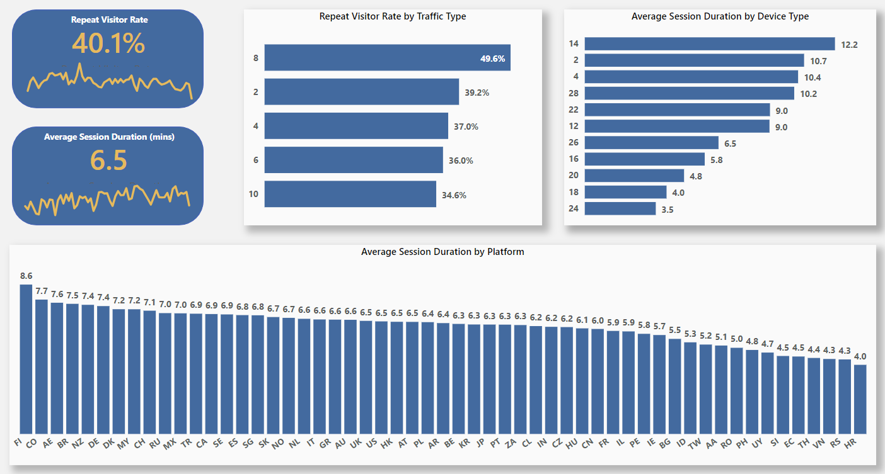
Repeat Visitor Rate & Avg Session Durations

Slide 12
Observations
Only about 40% of our users revisit our site after initial visit.
Our user retention rate has shown a gradual decline since our inception.
These observations suggest a need for the team to prioritize user retention strategies, including enhancing user experience, personalizing content for users, and potentially introducing loyalty programs.
Upon analyzing the traffic channels directing users to our site, it's evident that Channel 8 consistently attracts repeat users even with a bad clickout ratio . But Channels 2 and 4 not only drive users with a high inclination for clickouts but also tend to exhibit stronger user retention, they show viable strong traffic channel options.
Users utilizing devices 18 and 24 tend to have a poor average session duration compared to devices like 14, 2 and 4. These devices need to be looked at and investigated further.
Platforms such as FL, CO, and AE exhibit longer average session durations among users, contrasting with platforms like VN, RS, and HR. This trend highlights the varying user engagement across different platforms.
The comparison between the platform-based average session duration chart and the initial analysis, where only around half of our sessions exceed a minute, indicates that within each platform, there are frequent extremely lengthy sessions, causing the average values to be higher. Investigating the actions of users in this category can offer insights into why they spend extended periods on the site. Understanding these behaviors could aid in enhancing the overall user experience to encourage similar lengthy sessions for other users.

Slide 13

trivago
Task 2
User Actions

Slide 14
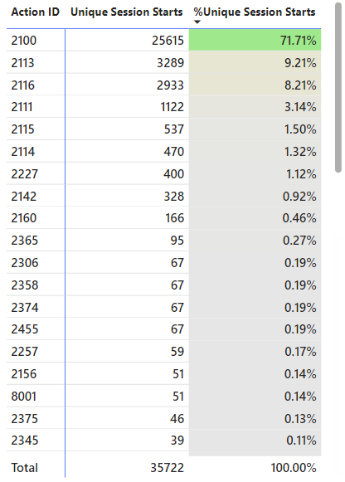
Challenge 2 – User Actions (Part 1)
I tried exploring a typical user session on the Trivago website and observe the interactions of a typical user journey on the platform. Some of the ways I can see a session starting are highlighted below:
Acceptance of Cookies Prompt: This step involves consenting to the 'all cookies' pop-up, enabling Trivago to uniquely identify the user via a tracking ID. This action also provides crucial metadata, including device information and user location, enhancing the session experience.
"Sign Up/Log In" Functionality: This feature serves the purpose of user identification across multiple devices. This pivotal action aids Trivago in maintaining a seamless and personalized experience for the user, ensuring continuity, ease of access.
Engagement with the "ChatGPT AI" Interface: This AI-driven conversational feature serves as a valuable resource, providing users with personalized guidance, supplementing traditional search methodologies.
Utilization of the "Search Feature": The feature reflects users' intent to directly explore and discover optimal accommodation options. This feature streamlines the user journey by providing arrays of filter options to better aid the users’ search.
These steps typically represent how I would expect sessions to start for users on the trivago website. Delving into what these actions could be from the data can be seen on the right.
This analysis shows the predominant actions that initiate sessions on the Trivago website based on the user action data. Notably, action 2100 stands out significantly, constituting approximately 72% of all session starts, suggesting its prominence among the user interactions observed. It is presumed that these top actions align with the earlier mentioned start features integrated into the platform from my exploration.
Delving into the actions diverging from this prevalent pattern gives the product team a valuable opportunity to gain insights into user sessions that deviate from the norm. This could provide a pathway for the team to enhance and optimize user experiences by better understanding the nuances and needs of users engaging in different session initiation behaviors.

Slide 15
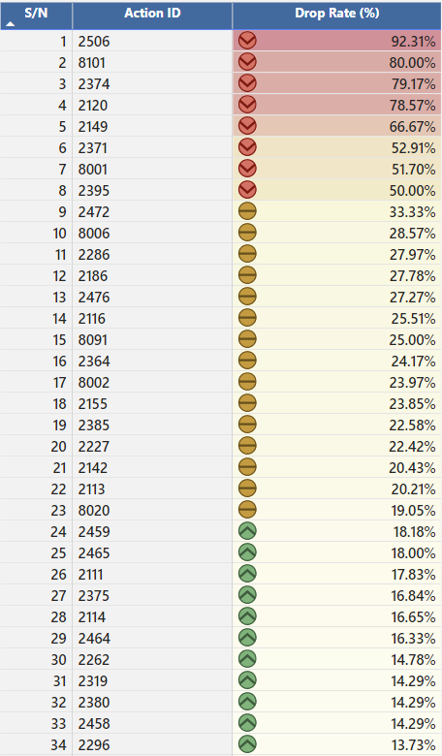
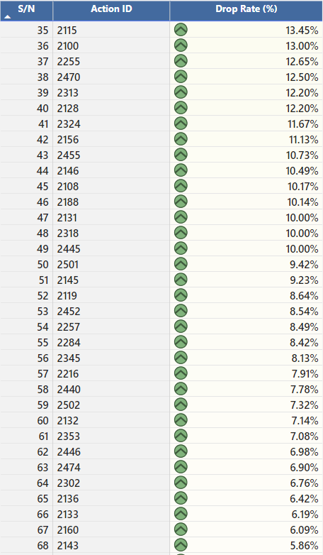
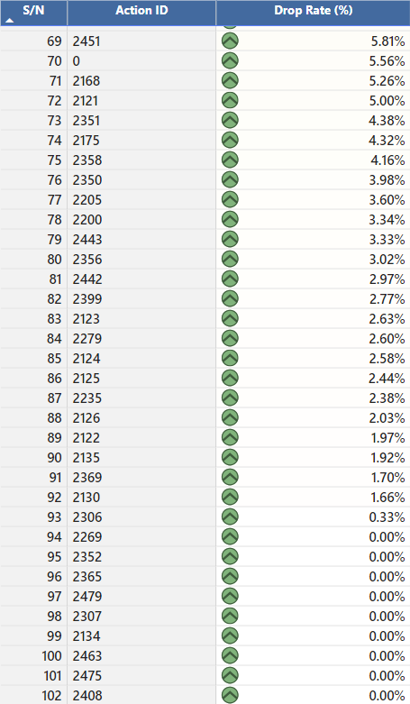
Challenge 2 – User Actions (Part 2)
Drop Rate for Action 1 = (Number of sessions where Action 1 is the last action / Total number of sessions where Action 1 occurs) * 100

Slide 16
Challenge 2 – User Actions (Part 3)
Considering potential actions that might be viewed as conversions while I was navigating the Trivago website, I've compiled the
following list;
Click Throughs to partner sites – Users clicking through to external partner sites to view deals, explore accommodations, or complete bookings. This action indicates a significant step towards potential hotel reservations.
User Account Sign Up – Users registration or sign-up for personalized experiences on the website. Account creation fosters user engagement, offering features like saved preferences and easy access to previous searches.
Return Visits to the Site – Users revisiting the Trivago website after their initial visit. Returning visits often signify sustained interest or ongoing engagement with accommodation options.
Voluntary Subscription to Notifications – Opting-in for notifications such as travel recommendations, exclusive offers, or newsletters. This action demonstrates user interest in receiving tailored information for future travel plans.
Saving or Sharing Accommodation Options – Users saving preferred accommodations to favorites or sharing them. This action indicates a higher level of user engagement and intent to consider specific options for potential bookings.
Engagement with Trivago’s AI Travel Assistant or Customer Support – Interacting with AI-driven travel assistance or customer support features. Engagements with these services signify users seeking guidance or assistance in their accommodation search, potentially guiding them towards booking decisions.

Slide 17
Challenge 2 – User Actions (Part 3)
Upon reviewing the available data, certain fields within the sessions dataset appear to align with identifying potential conversions as mentioned earlier:
Clickouts Column in the Sessions Dataset – This field helps to find sessions that resulted in click-throughs redirecting users to partner sites. It aids in understanding user behaviors that potentially lead to external bookings.
Is_Repeater Column in the Sessions Dataset – This field assists in identifying users who revisit the Trivago site, indicating sustained engagement or interest over multiple sessions.
Unfortunately, the datasets either encodes or do not contain sufficient information to capture the other potential conversions mentioned earlier, thereby limiting the ability to assess those specific conversion actions based solely on the available data.
Steps used to determine the actions to higher numbers of conversions for the cases above;
S/N | Clickouts Column in the Sessions Dataset | Is_Repeater Column in the Sessions Dataset
1 | Find all sessions that led to at least a clickout in the sessions data and filter the dataset down to just those sessions | Find all sessions that had the is_repeater flag as 1 in the sessions data and filter the dataset down to just those sessions
2 | Join the filtered dataset to the actions dataset to include only actions in the sessions from the filtered above. | Join the filtered dataset to the actions dataset to include only actions in the sessions from the filtered above.
3 | Count the actions across the sessions to see which actions are prominent to sessions that eventually lead to clickouts | Count the actions across the sessions to see which actions are prominent to sessions that eventually lead to a user revisiting the site

Slide 18
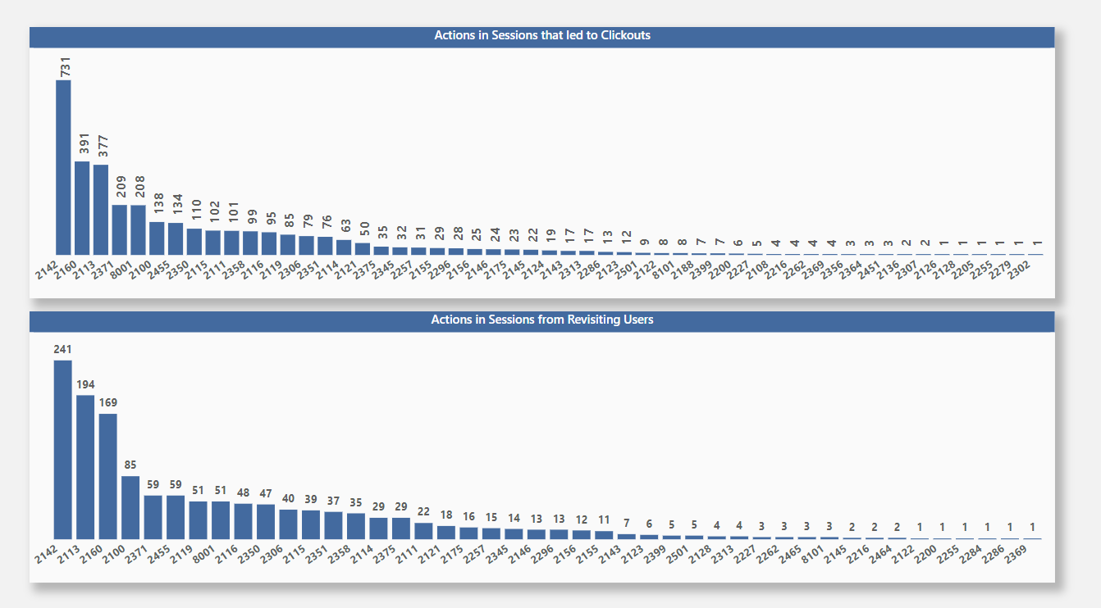
Challenge 2 – User Actions (Part 3)

Slide 19
Challenge 2 – User Actions (Part 3)
Upon close examination of both charts that shows a depiction of action distributions among users in sessions resulting in clickouts and those revisiting the site, it becomes evident that notable similarities exist. The actions correlating with higher numbers of conversions exhibit striking similarities across both scenarios and prominently stand out in the charts. The top six actions identified are as follows:
2142
2160
2113
2371
8001
2001
These actions demonstrate consistency in their occurrence among sessions leading to clickouts and users revisiting the site, indicating their potential significance in contributing to conversions in both contexts.

Slide 20








Tools Used while working on this Case Study
MS Excel
Python
SQL
MS Power BI

Slide 21
trivago
THANK YOU
By Oluwatobi Ojo

